Slide 1
Consensus partitioning
Final lecture in Modern Data Analysis 2018

Slide 2
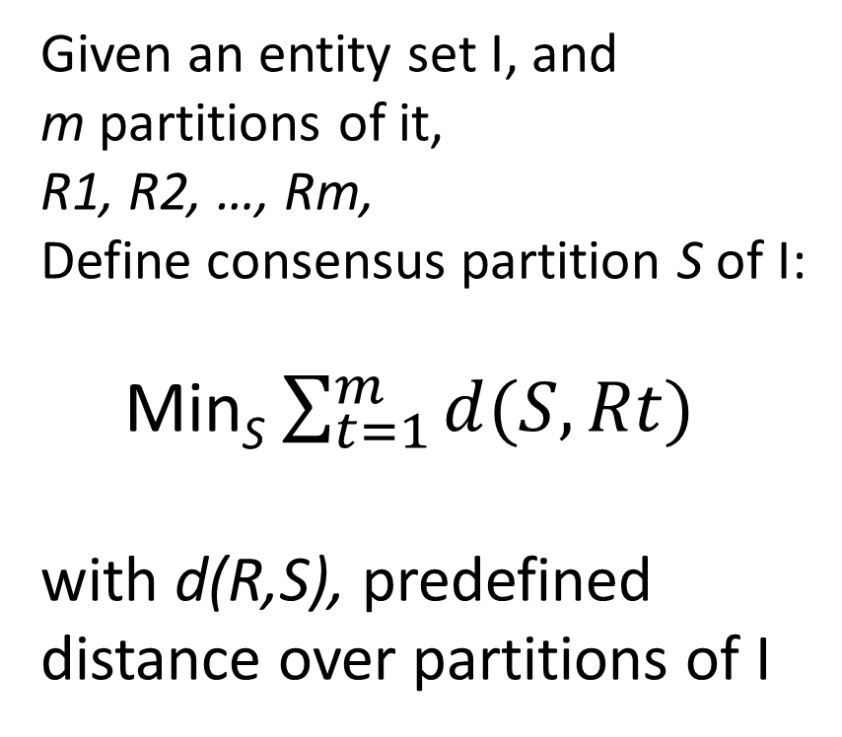
Consensus partition operationally
Given an entity set I, and
m partitions of it,
R1, R2, …, Rm,
Define consensus partition S of I:
Min_{S} $\sum_{t=1}^{m}{d(S,Rt)}$
with d(R,S), predefined distance over partitions of I
R1 R2
R3

Slide 3
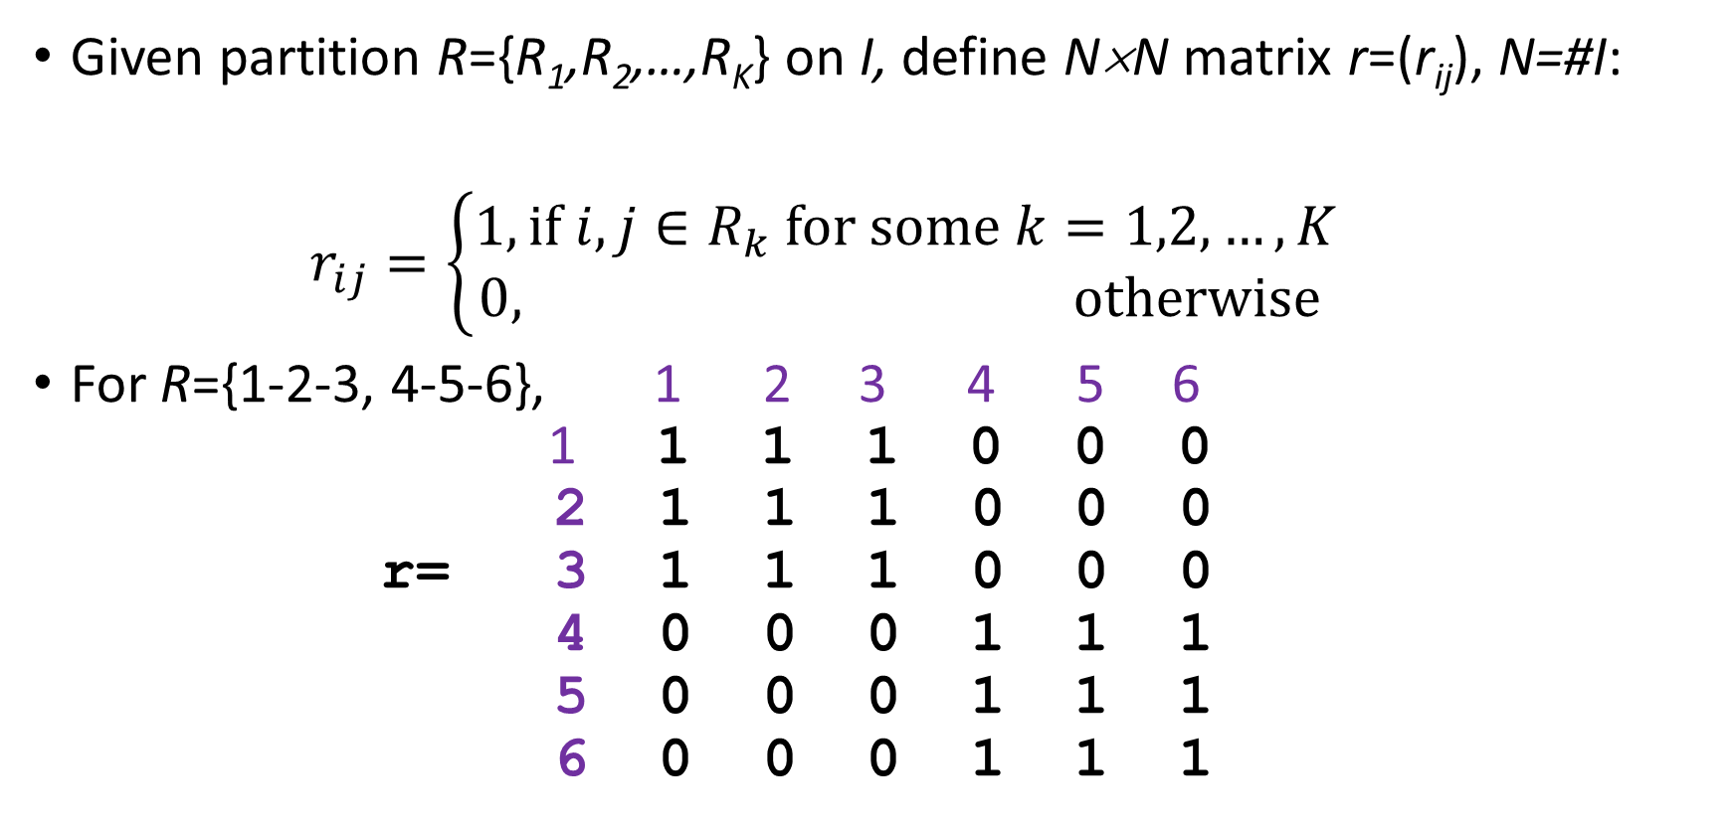
Mismatch (Mirkin’s) distance between partitions, 1
Given partition R={R₁,R₂,…,R_{K}} on I, define N×N matrix r=(r_{ij}), N=#I:
$r_{ij}=\left\{\begin{aligned}1,if i,j∈R_{k} for some k=1,2,…,K \\ 0, otherwise \end{aligned}\right.$
For R={1-2-3, 4-5-6}, 1 2 3 4 5 6
1 1 1 1 0 0 0
2 1 1 1 0 0 0
r= 3 1 1 1 0 0 0
4 0 0 0 1 1 1
5 0 0 0 1 1 1
6 0 0 0 1 1 1

Slide 4
Mismatch distance between partitions, 2
A binary N×N matrix to correspond to any partition:
R={1-2-3, 4-5-6}, S={1-3, 2-4-5-6}, T={1-4, 2-5, 3-6}
1 23 456 1 234 56 1 234 5 6
1 111000 101000 100100
2 111000 010111 010010
3 111000 101000 001001
4 000111 010111 100100
5 000111 010111 010010
6 000111 010111 001001

Slide 5
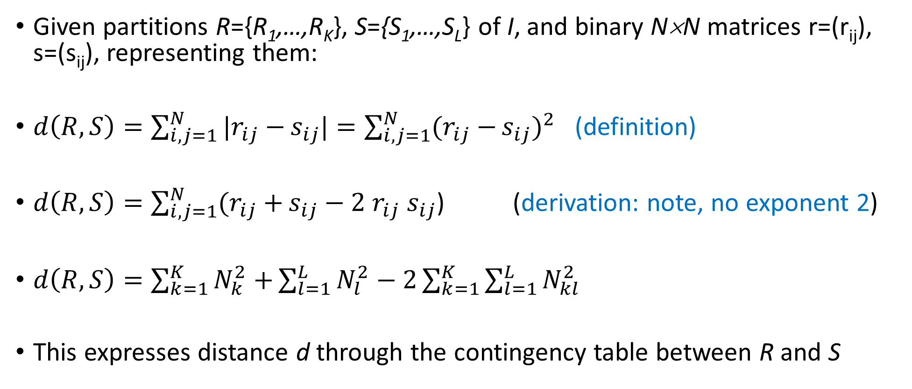
Mismatch distance between partitions, 3
Given partitions R={R₁,…,R_{K}}, S={S₁,…,S_{L}} of I, and binary N×N matrices r=(r_{ij}), s=(s_{ij}), representing them:
$d\left(R,S\right)=\sum_{i,j=1}^{N}{|r_{ij}−}s_{ij}|=\sum_{i,j=1}^{N}{(r_{ij}−}s_{ij})^{2}$ (definition)
$d\left(R,S\right)=\sum_{i,j=1}^{N}{(r_{ij}+}s_{ij}−2$ $r_{ij}$ $s_{ij}$) (derivation: note, no exponent 2)
$d\left(R,S\right)=\sum_{k=1}^{K}{N_{k}^{2}+}\sum_{l=1}^{L}{N_{l}^{2}−2}\sum_{k=1}^{K}{\sum_{l=1}^{L}{N_{kl}^{2}}}$
This expresses distance d through the contingency table between R and S

Slide 6
Quiz: what is the maximum distance between partitions on I
Tip: N(N-1) where N=#I. That is the mismatch distance between trivial partition 0 consisting of N singletons, and the universal partition consisting of just one part, the set I itself.

Slide 7
Example of Mismatch distance
R={1-2-3, 4-5-6}, S={1-3, 2-4-5-6}, T={1-4, 2-5, 3-6}
1 234 56 1 234 56 1 234 5 6
1 111000 101000 100100
2 111000 010111 010010
3 111000 101000 001001
4 000111 010111 100100
5 000111 010111 010010
6 000111 010111 001001
Compute d(R,S)=|R|+|S|-2|RS|=(3²+3²)+(2²+4²) – 2(2²+1²+3²)=18+20-28=10, since RS={1-3, 2, 4-5-6}.
Relative distance is δ(R,S)=d(R,S)/[N(N-1)]=10/30=0.33.
Quiz: Compute d(R,T),d(S,T).

Slide 8
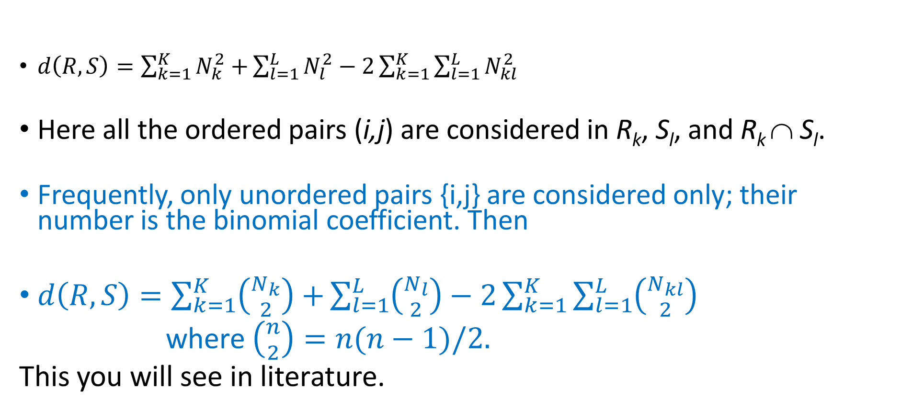
Mismatch distance between partitions, 4
$d\left(R,S\right)=\sum_{k=1}^{K}{N_{k}^{2}+}\sum_{l=1}^{L}{N_{l}^{2}−2}\sum_{k=1}^{K}{\sum_{l=1}^{L}{N_{kl}^{2}}}$
Here all the ordered pairs (i,j) are considered in R_{k}, S_{l}, and R_{k} ∩ S_{l}.
Frequently, only unordered pairs {i,j} are considered only; their number is the binomial coefficient. Then
$d\left(R,S\right)=\sum_{k=1}^{K}{\left({N_{k} \atop 2}\right)+}\sum_{l=1}^{L}{\left({N_{l} \atop 2}\right)−2}\sum_{k=1}^{K}{\sum_{l=1}^{L}{\left({N_{kl} \atop 2}\right)}}$
where $\left({n \atop 2}\right)=n(n−1)/2.$
This you will see in literature.

Slide 9
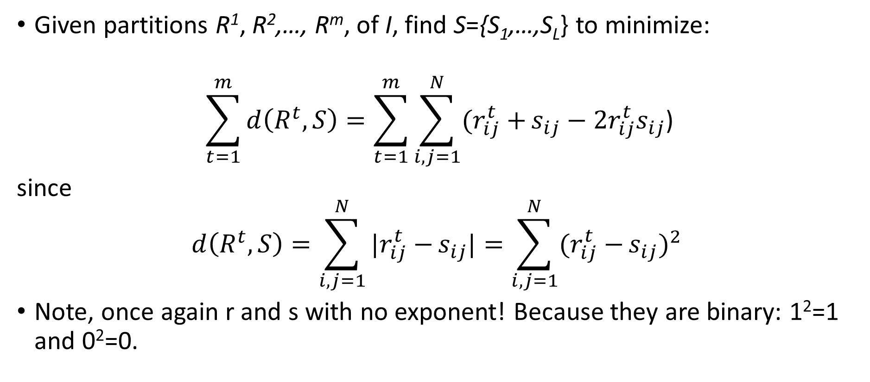
Consensus partition with mismatch distance,1
Given partitions R¹, R²,…, R^{m}, of I, find S={S₁,…,S_{L}} to minimize:
$$\sum_{t=1}^{m}{d\left(R^{t},S\right)}=\sum_{t=1}^{m}{\sum_{i,j=1}^{N}{(r_{ij}^{t}+}s_{ij}−2r_{ij}^{t}s_{ij}\text{)}}$$
since
$$d\left(R^{t},S\right)=\sum_{i,j=1}^{N}{|r_{ij}^{t}−}s_{ij}|=\sum_{i,j=1}^{N}{(r_{ij}^{t}−}s_{ij})^{2}$$
Note, once again r and s with no exponent! Because they are binary: 1²=1 and 0²=0.

Slide 10
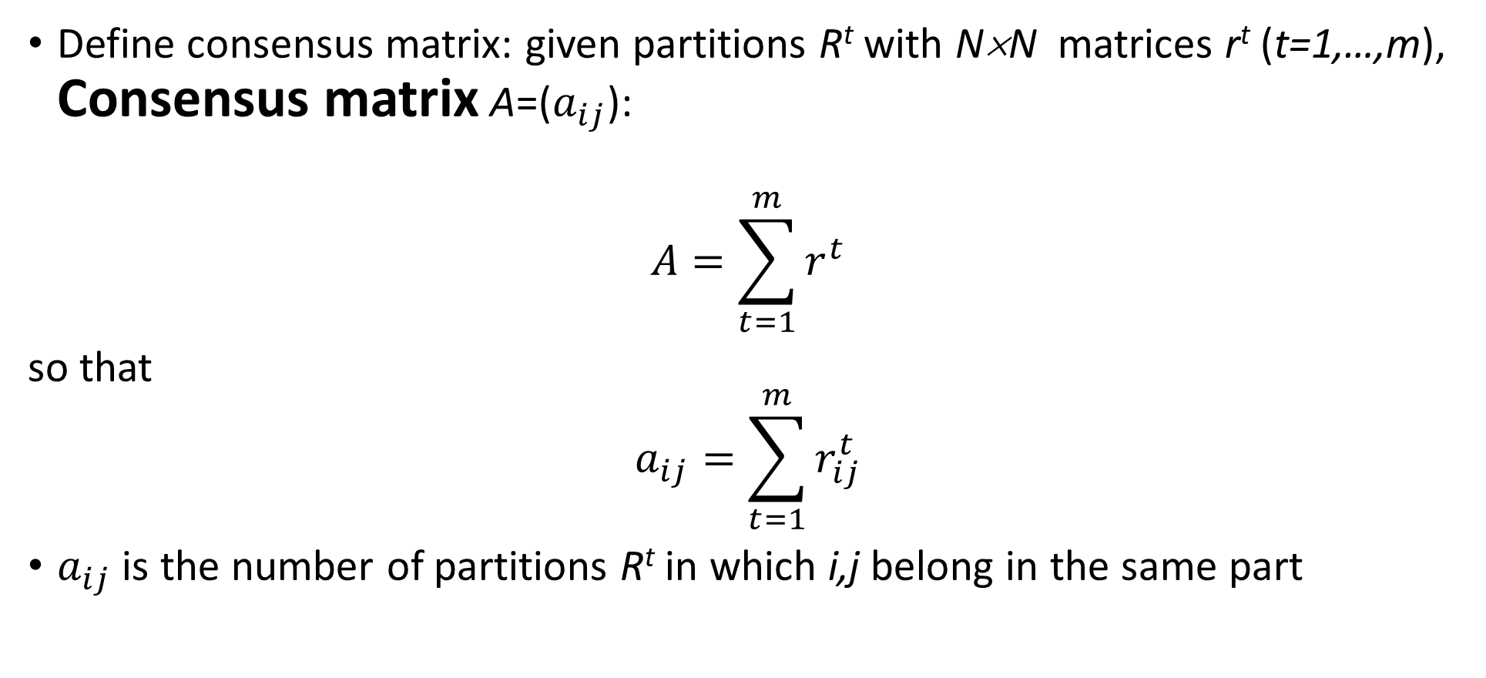
Consensus partition with mismatch distance,2
Define consensus matrix: given partitions R^{t} with N×N matrices r^{t} (t=1,…,m), Consensus matrix A=($a_{ij}$):
$$A=\sum_{t=1}^{m}{r^{t}}$$
so that
$$a_{ij}=\sum_{t=1}^{m}{r_{ij}^{t}}$$
$a_{ij}$ is the number of partitions R^{t} in which i,j belong in the same part

Slide 11
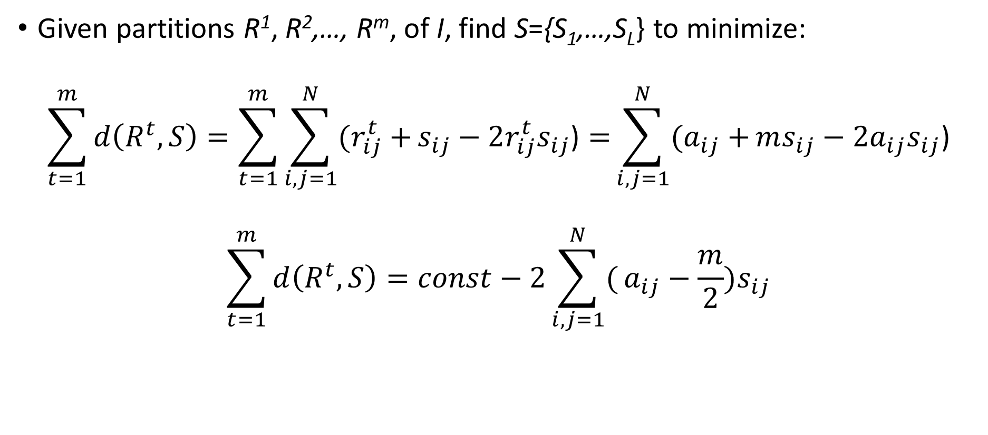
Consensus partition with mismatch distance,3
Given partitions R¹, R²,…, R^{m}, of I, find S={S₁,…,S_{L}} to minimize:
$$\sum_{t=1}^{m}{d\left(R^{t},S\right)}=\sum_{t=1}^{m}{\sum_{i,j=1}^{N}{(r_{ij}^{t}+}s_{ij}−2r_{ij}^{t}s_{ij}\text{)}=}\sum_{i,j=1}^{N}{(a_{ij}+}ms_{ij}−2a_{ij}s_{ij}\text{)}$$
$$\sum_{t=1}^{m}{d\left(R^{t},S\right)}=const−2\sum_{i,j=1}^{N}{(}a_{ij}−\frac{m}{2})s_{ij}$$

Slide 12
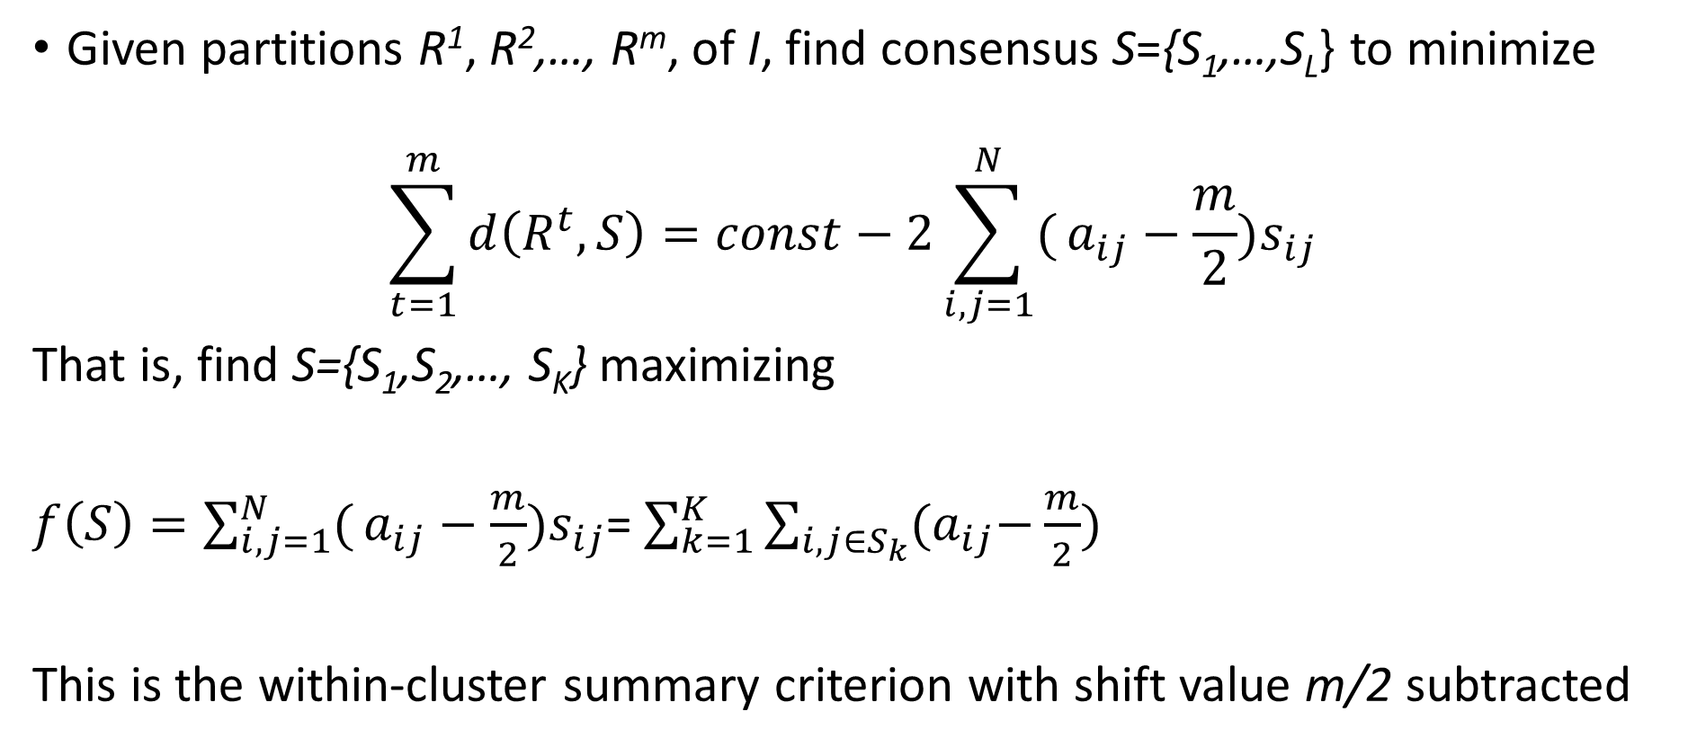
Consensus partition with mismatch distance,4
Given partitions R¹, R²,…, R^{m}, of I, find consensus S={S₁,…,S_{L}} to minimize
$$\sum_{t=1}^{m}{d\left(R^{t},S\right)}=const−2\sum_{i,j=1}^{N}{(}a_{ij}−\frac{m}{2})s_{ij}$$
That is, find S={S₁,S₂,…, S_{K}} maximizing
$f\left(S\right)=\sum_{i,j=1}^{N}{(}a_{ij}−\frac{m}{2})s_{ij}$= $\sum_{k=1}^{K}{\sum_{i,j∈S_{k}}{{(a}_{ij}−\frac{m}{2}) }}$
This is the within-cluster summary criterion with shift value m/2 subtracted

Slide 13
Example: m=11 partitions of the Ten Digits 4 parts in R6, R7; 3 parts in the 9 others
Digit | R1 R2 R3 R4 R5 R6 R7 R8 R9 R10 R11
1 2 3 4 5 6 7 8 9 0 | 1 1 1 2 1 1 1 1 1 2 1 2 2 2 2 3 3 3 2 2 3 2 3 3 3 2 3 3 4 3 3 2 3 3 1 1 3 3 1 1 1 3 2 1 3 3 3 1 2 2 2 3 3 1 3 2 2 2 1 2 2 2 2 2 1 2 1 1 1 2 1 3 1 1 1 2 1 2 2 2 3 3 4 3 2 2 3 2 3 3 3 3 3 3 4 3 3 3 3 2 2 2 2 3 4 3 2 2 3 2

Slide 14
Example: Consensus matrix for m=11 partitions of the Ten Digits
 | 1 2 3 4 5 6 7 8 9 0
1 2 3 4 5 6 7 8 9 0 | 11 1 2 7 0 0 10 0 0 1 1 11 3 1 0 6 2 9 3 10 2 3 11 4 6 0 3 1 9 2 7 1 4 11 2 0 6 2 4 1 0 0 6 2 11 5 0 0 6 0 0 6 0 0 5 11 0 6 0 6 10 2 3 6 0 0 11 0 1 1 0 9 1 2 0 6 0 11 3 10 0 3 9 4 6 0 1 3 11 2 1 10 2 1 0 6 1 10 2 11

Slide 15
Example: Consensus matrix for m=11 partitions of the Ten Digits, with m/2=5.5 subtracted and diagonal zeroed
 | 1 2 3 4 5 6 7 8 9 0
1 2 3 4 5 6 7 8 9 0 | 0 -4.5 -3.5 1.5 -5.5 -5.5 4.5 -5.5 -5.5 -4.5 -4.5 0 -2.5 -4.5 -5.5 0.5 -3.5 3.5 -2.5 4.5 -3.5 -2.5 0 -1.5 0.5 -5.5 -2.5 -4.5 3.5 -3.5 1.5 -4.5 -1.5 0 -3.5 -5.5 0.5 -3.5 -1.5 -4.5 -5.5 -5.5 0.5 -3.5 0 -0.5 -5.5 -5.5 0.5 -5.5 -5.5 0.5 -5.5 -5.5 -0.5 0 -5.5 0.5 -5.5 0.5 4.5 -3.5 -2.5 0.5 -5.5 -5.5 0 -5.5 -4.5 -4.5 -5.5 3.5 -4.5 -3.5 -5.5 0.5 -5.5 0 -2.5 4.5 -5.5 -2.5 3.5 -1.5 0.5 -5.5 -4.5 -2.5 0 -3.5 -4.5 4.5 -3.5 -4.5 -5.5 0.5 -4.5 4.5 -3.5 0

Slide 16
Example: Consensus matrix for m=11 partitions of the Ten Digits, with m/2=5.5 subtracted and diagonal zeroed
Clusters are obvious here:
S₁ 1-4-7
S₂ 2-6-8-0
S₃ 3-5-9
Why obvious?
All positive entries
within clusters, all
negative entries
between clusters,
Thus making value of f(S) the global maximum.
 | 1 2 3 4 5 6 7 8 9 0
1 2 3 4 5 6 7 8 9 0 | 0 -4.5 -3.5 1.5 -5.5 -5.5 4.5 -5.5 -5.5 -4.5 -4.5 0 -2.5 -4.5 -5.5 0.5 -3.5 3.5 -2.5 4.5 -3.5 -2.5 0 -1.5 0.5 -5.5 -2.5 -4.5 3.5 -3.5 1.5 -4.5 -1.5 0 -3.5 -5.5 0.5 -3.5 -1.5 -4.5 -5.5 -5.5 0.5 -3.5 0 -0.5 -5.5 -5.5 0.5 -5.5 -5.5 0.5 -5.5 -5.5 -0.5 0 -5.5 0.5 -5.5 0.5 4.5 -3.5 -2.5 0.5 -5.5 -5.5 0 -5.5 -4.5 -4.5 -5.5 3.5 -4.5 -3.5 -5.5 0.5 -5.5 0 -2.5 4.5 -5.5 -2.5 3.5 -1.5 0.5 -5.5 -4.5 -2.5 0 -3.5 -4.5 4.5 -3.5 -4.5 -5.5 0.5 -4.5 4.5 -3.5 0

Slide 17
However, consensus partition for mismatch distance fails the Muchnik test.
Muchnik test
Take a partition R={R₁,R₂,…,R_{K}} of I in K≥2 parts R_{k} .
Create a set of K two-part partitions Rk={R_{k}, I-R_{k}}, k=1,2,…, K.
Find a consensus partition S for the K two-part partitions Rk, k=1,2,…, K.
If S==R, the test is passed; if not, the test is failed.

Slide 18
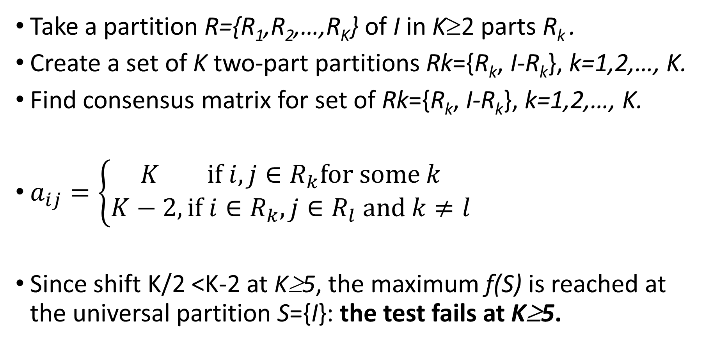
Muchnik test for mismatch distance
Take a partition R={R₁,R₂,…,R_{K}} of I in K≥2 parts R_{k} .
Create a set of K two-part partitions Rk={R_{k}, I-R_{k}}, k=1,2,…, K.
Find consensus matrix for set of Rk={R_{k}, I-R_{k}}, k=1,2,…, K.
$a_{ij}=\left\{\begin{aligned}K if i,j∈R_{k}for some k \\ K−2,if i∈R_{k}, j∈R_{l} and k≠l\end{aligned}\right.$
Since shift K/2 <K-2 at K≥5, the maximum f(S) is reached at the universal partition S={I}: the test fails at K≥5.

Slide 19
Therefore, Mismatch distance fails Muchnik test and is not that good, overall.
Luckily, a similar distance can be defined to pass the Muchnik test: the regression distance.

Slide 20
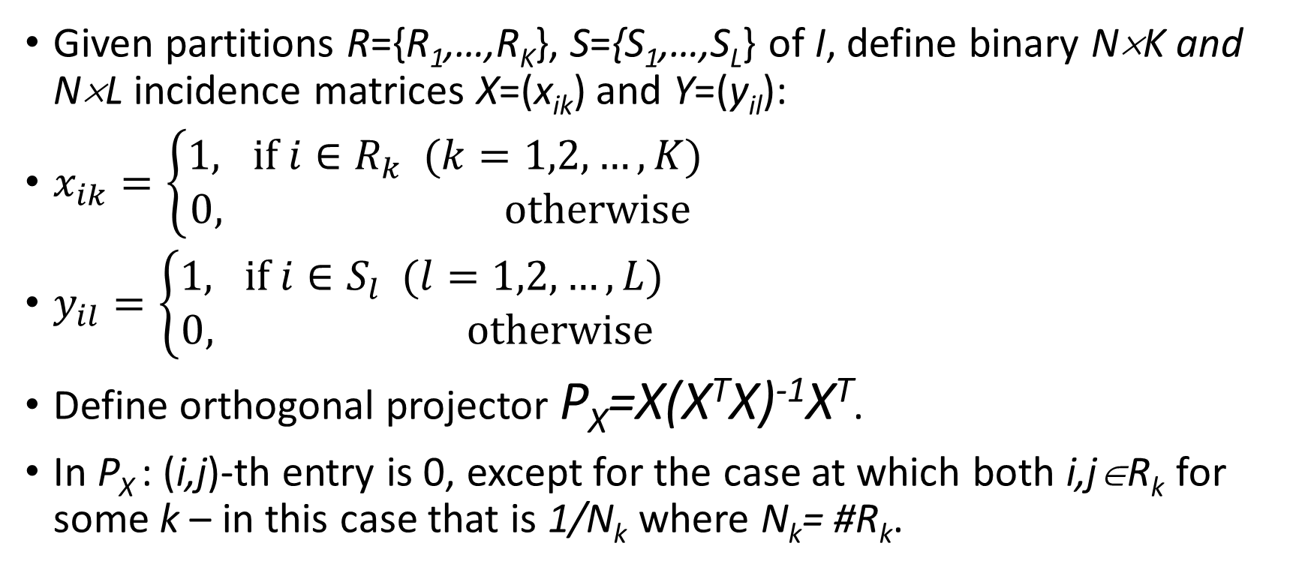
Regression distance between partitions,1
Given partitions R={R₁,…,R_{K}}, S={S₁,…,S_{L}} of I, define binary N×K and N×L incidence matrices X=(x_{ik}) and Y=(y_{il}):
$x_{ik}=\left\{\begin{aligned}1, if i∈R_{k} (k=1,2,…,K) \\ 0, otherwise \end{aligned}\right.$
$y_{il}=\left\{\begin{aligned}1, if i∈S_{l} (l=1,2,…,L) \\ 0, otherwise \end{aligned}\right.$
Define orthogonal projector P_{X}=X(X^{T}X)⁻¹X^{T}.
In P_{X} : (i,j)-th entry is 0, except for the case at which both i,j∈R_{k} for some k – in this case that is 1/N_{k} where N_{k}= #R_{k}.

Slide 21
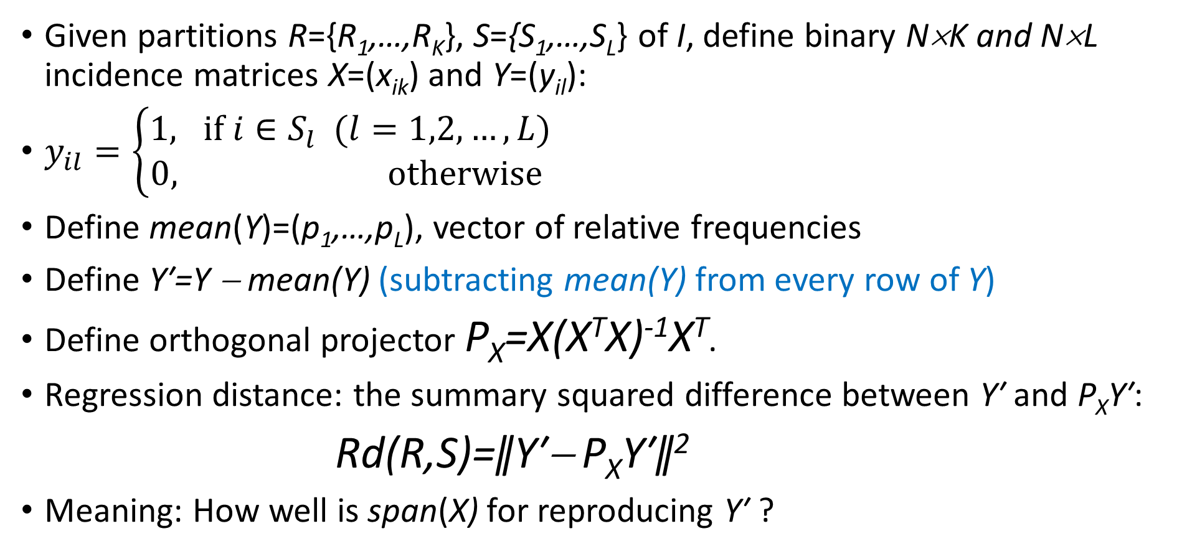
Regression distance between partitions,2
Given partitions R={R₁,…,R_{K}}, S={S₁,…,S_{L}} of I, define binary N×K and N×L incidence matrices X=(x_{ik}) and Y=(y_{il}):
$y_{il}=\left\{\begin{aligned}1, if i∈S_{l} (l=1,2,…,L) \\ 0, otherwise \end{aligned}\right.$
Define mean(Y)=(p₁,…,p_{L}), vector of relative frequencies
Define Y′=Y − mean(Y) (subtracting mean(Y) from every row of Y)
Define orthogonal projector P_{X}=X(X^{T}X)⁻¹X^{T}.
Regression distance: the summary squared difference between Y′ and P_{X}Y′:
Rd(R,S)=ǁY′− P_{X}Y′ǁ²
Meaning: How well is span(X) for reproducing Y′ ?

Slide 22
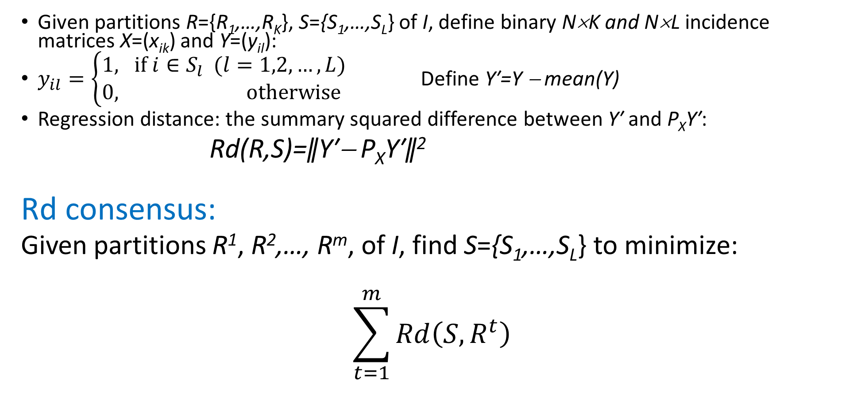
Regression distance Rd between partitions,3
Given partitions R={R₁,…,R_{K}}, S={S₁,…,S_{L}} of I, define binary N×K and N×L incidence matrices X=(x_{ik}) and Y=(y_{il}):
$y_{il}=\left\{\begin{aligned}1, if i∈S_{l} (l=1,2,…,L) \\ 0, otherwise \end{aligned}\right.$ Define Y′=Y − mean(Y)
Regression distance: the summary squared difference between Y′ and P_{X}Y′:
Rd(R,S)=ǁY′− P_{X}Y′ǁ²
Rd consensus:
Given partitions R¹, R²,…, R^{m}, of I, find S={S₁,…,S_{L}} to minimize:
$$\sum_{t=1}^{m}{Rd\left(S,R^{t}\right)}$$

Slide 23
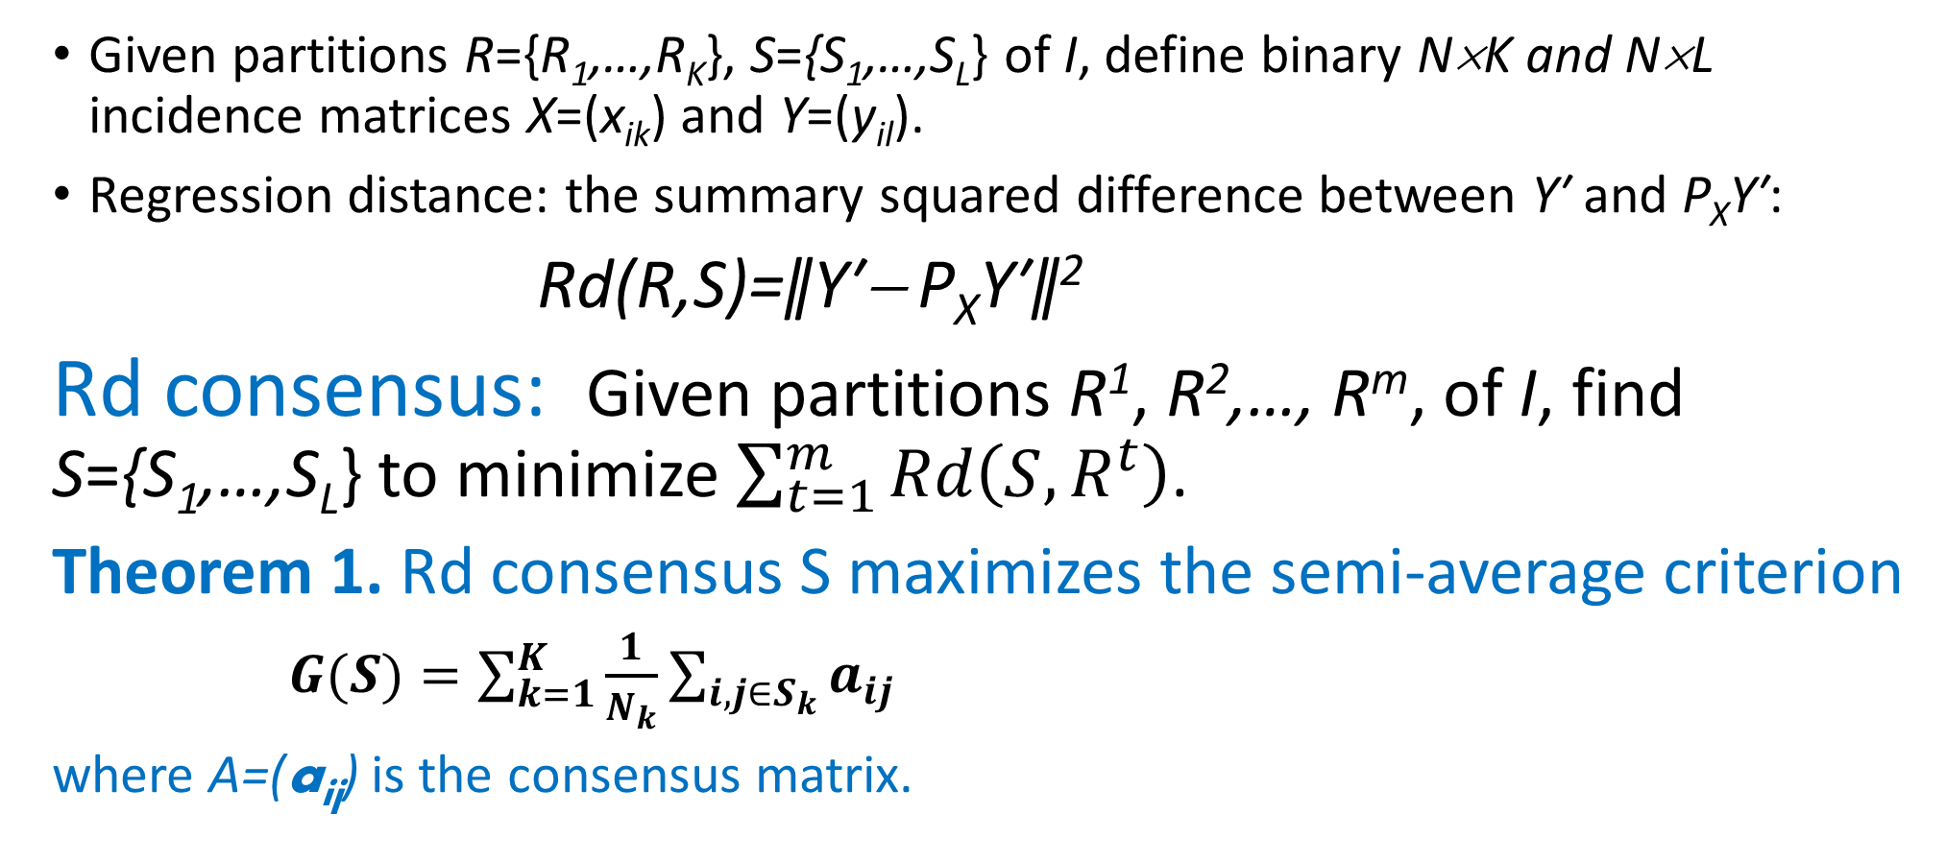
Regression distance consensus,1
Given partitions R={R₁,…,R_{K}}, S={S₁,…,S_{L}} of I, define binary N×K and N×L incidence matrices X=(x_{ik}) and Y=(y_{il}).
Regression distance: the summary squared difference between Y′ and P_{X}Y′:
Rd(R,S)=ǁY′− P_{X}Y′ǁ²
Rd consensus: Given partitions R¹, R²,…, R^{m}, of I, find S={S₁,…,S_{L}} to minimize $\sum_{t=1}^{m}{Rd\left(S,R^{t}\right)}$.
Theorem 1. Rd consensus S maximizes the semi-average criterion
$G(S)=\sum_{k=1}^{K}{\frac{1}{N_{k}}}\sum_{i,j∈S_{k}}{a_{ij}}$
where A=(a_{ij}) is the consensus matrix.

Slide 24
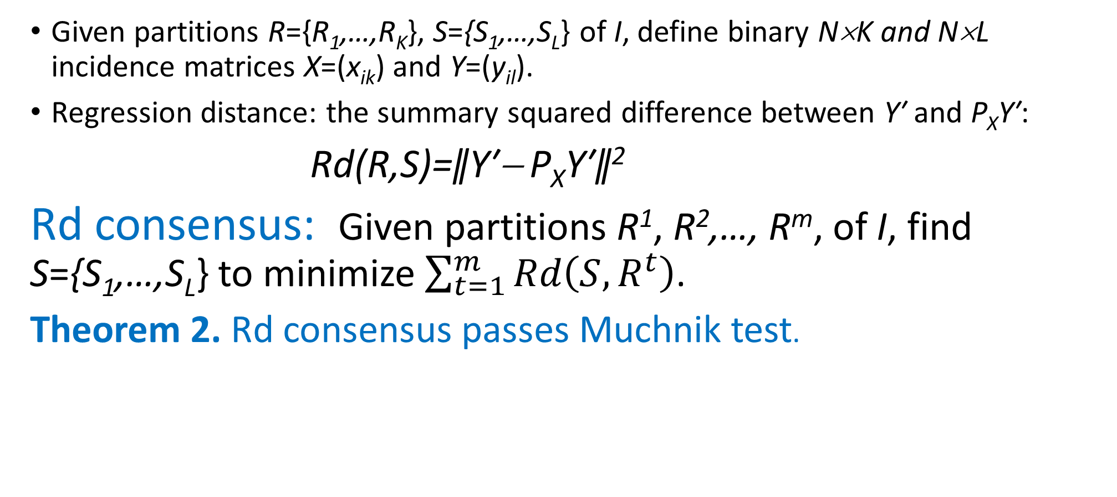
Regression distance consensus,2
Given partitions R={R₁,…,R_{K}}, S={S₁,…,S_{L}} of I, define binary N×K and N×L incidence matrices X=(x_{ik}) and Y=(y_{il}).
Regression distance: the summary squared difference between Y′ and P_{X}Y′:
Rd(R,S)=ǁY′− P_{X}Y′ǁ²
Rd consensus: Given partitions R¹, R²,…, R^{m}, of I, find S={S₁,…,S_{L}} to minimize $\sum_{t=1}^{m}{Rd\left(S,R^{t}\right)}$.
Theorem 2. Rd consensus passes Muchnik test.

Slide 25
Experimental observation
ISSUE: At multiple runs of K-Means, the output is a set of partitions of the entity set. Which one of them to choose?
Strategy 1. Choose the partition S1, that is the best over K-Means criterion W(S,c), that is, minimizes W(S,c).
Strategy 2. Build a consensus partition S2.
At synthetic data (K Gaussian clusters generated with various degree of noise), S2 usually is worse than S1 over W(S,c), but better than S1 in recovering the generated clusters.

Slide 26
Lecture contents
Statement of the problem of consensus partition
Introduction to Mismatch (Mirkin’s) distance between partitions
Consensus matrix
Mismatch distance consensus partition as a maximizer of the within cluster summary consensus similarity
Muchnik test and failure of the mismatch distance consensus
Regression distance between partitions
Regression distance consensus partition as a maximizer of the semi-average consensus similarity

